Slide 1
CS162 Operating Systems and Systems Programming Lecture 17 Performance Storage Devices, Queueing Theory
May 31st, 2020
Prof. John Kubiatowicz
http://cs162.eecs.Berkeley.edu

Slide 2
Recall: How the processor talks to the device
Processor Memory Bus
Regular
Memory
CPU
Bus
Adaptor
Bus
Adaptor
Device Controller
Address +
Data
Other Devices
or Buses
Bus
Interface
Hardware
Controller
Interrupt
Controller
Interrupt Request
read
Addressable
Memory
and/or
Queues
write
control
CPU interacts with a Controller
Contains a set of registers that can be read and written
May contain memory for request queues or bit-mapped images
Regardless of the complexity of the connections and buses, processor accesses registers in two ways:
I/O instructions: in/out instructions
Example from the Intel architecture: out 0x21,AL
Memory mapped I/O: load/store instructions
Registers/memory appear in physical address space
I/O accomplished with load and store instructions
status
Registers
(port 0x20)
Memory Mapped
Region: 0x8F008020

Slide 3
Recall: Memory-Mapped Display Controller
Memory-Mapped:
Hardware maps control registers and display memory into physical address space
Addresses set by HW jumpers or at boot time
Simply writing to display memory (also called the “frame buffer”) changes image on screen
Addr: 0x8000F000 — 0x8000FFFF
Writing graphics description to cmd queue
Say enter a set of triangles describing some scene
Addr: 0x80010000 — 0x8001FFFF
Writing to the command register may cause on-board graphics hardware to do something
Say render the above scene
Addr: 0x0007F004
Can protect with address translation
0x80020000
Graphics
Command
Queue
0x80010000
Display
Memory
0x8000F000
0x0007F004
Command
0x0007F000
Status
Physical
Address
Space

Slide 4
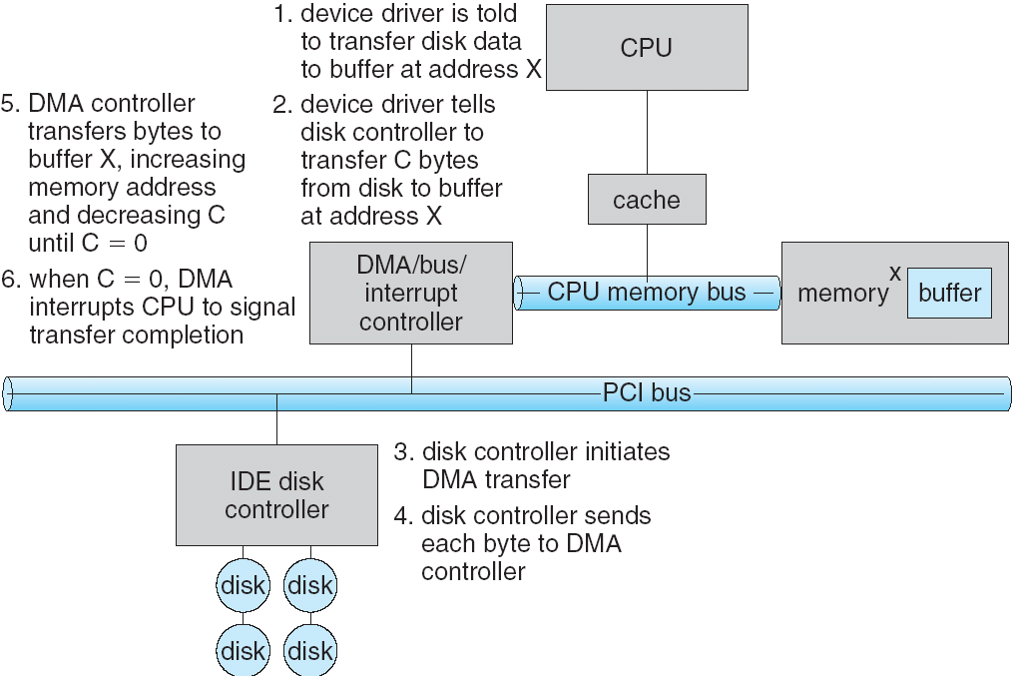
Transferring Data To/From Controller
Programmed I/O:
Each byte transferred via processor in/out or load/store
Pro: Simple hardware, easy to program
Con: Consumes processor cycles proportional to data size
Direct Memory Access:
Give controller access to memory bus
Ask it to transfer data blocks to/from memory directly
Sample interaction with DMA controller (from OSC book):
1
2
3

Slide 5
Transferring Data To/From Controller
Programmed I/O:
Each byte transferred via processor in/out or load/store
Pro: Simple hardware, easy to program
Con: Consumes processor cycles proportional to data size
Direct Memory Access:
Give controller access to memory bus
Ask it to transfer data blocks to/from memory directly
Sample interaction with DMA controller (from OSC book):
6
5
4

Slide 6
I/O Device Notifying the OS
The OS needs to know when:
The I/O device has completed an operation
The I/O operation has encountered an error
I/O Interrupt:
Device generates an interrupt whenever it needs service
Pro: handles unpredictable events well
Con: interrupts relatively high overhead
Polling:
OS periodically checks a device-specific status register
I/O device puts completion information in status register
Pro: low overhead
Con: may waste many cycles on polling if infrequent or unpredictable I/O operations
Actual devices combine both polling and interrupts
For instance – High-bandwidth network adapter:
Interrupt for first incoming packet
Poll for following packets until hardware queues are empty
Notes:
After the OS has issued a command to the I/O device either via a special I/O instruction or by writing to a location in the I/O address space, the OS needs to be notified when:
(a) The I/O device has completed the operation.
(b) Or when the I/O device has encountered an error.
This can be accomplished in two different ways: Polling and I/O interrupt.
+1 = 58 min. (Y:38)

Slide 7
Device Drivers
Device Driver: Device-specific code in the kernel that interacts directly with the device hardware
Supports a standard, internal interface
Same kernel I/O system can interact easily with different device drivers
Special device-specific configuration supported with the ioctl() system call
Device Drivers typically divided into two pieces:
Top half: accessed in call path from system calls
implements a set of standard, cross-device calls like open(), close(), read(), write(), ioctl(), strategy()
This is the kernel’s interface to the device driver
Top half will start I/O to device, may put thread to sleep until finished
Bottom half: run as interrupt routine
Gets input or transfers next block of output
May wake sleeping threads if I/O now complete

Slide 8
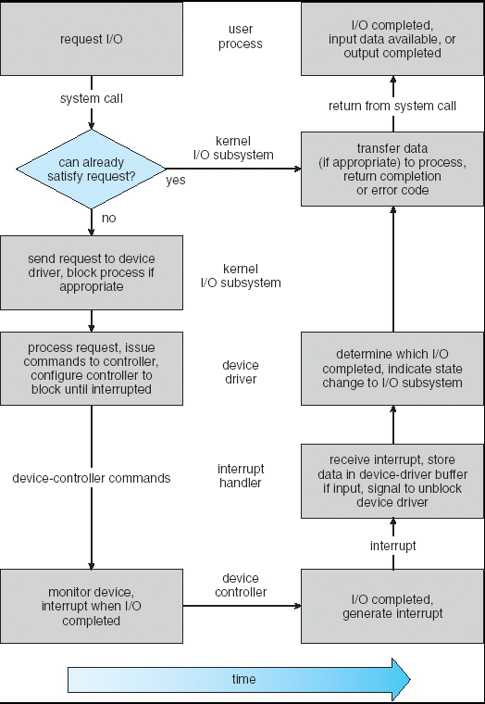
Life Cycle of An I/O Request
User
Program
Kernel I/O
Subsystem
Device Driver
Top Half
Device Driver
Bottom Half
Device
Hardware

Slide 9
Basic Performance Concepts
Response Time or Latency: Time to perform an operation(s)
Bandwidth or Throughput: Rate at which operations are performed (op/s)
Files: MB/s, Networks: Mb/s, Arithmetic: GFLOP/s
Start up or “Overhead”: time to initiate an operation
Most I/O operations are roughly linear in b bytes
Latency(b) = Overhead + b/TransferCapacity

Slide 10
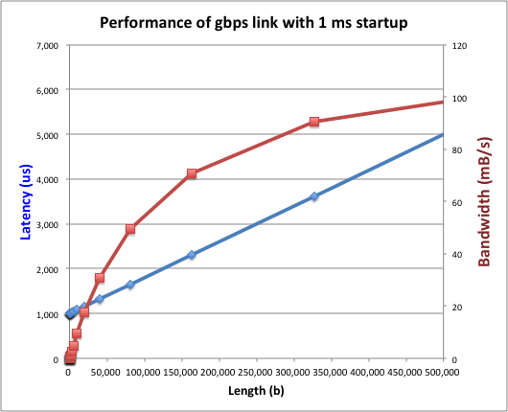
Example (Fast Network)
Consider a 1 Gb/s link (BW = 125 MB/s)
With a startup cost S = 1 ms
Latency(b) = S + b/BW
Bandwidth = b/(S + b/BW) = BW×b/(BW×S + b) = BW/(BW×S/b + 1)

Slide 11
Example (Fast Network)
Consider a 1 Gb/s link (BW = 125 MB/s)
With a startup cost S = 1 ms
Half-power Bandwidth ⇒ BW/(BW*S/b + 1) = BW/2
Half-power point occurs at b= S*BW = 125,000 bytes

Slide 12
Example: at 10 ms startup (like Disk)
Half-power b = 1,250,000 bytes!

Slide 13
What Determines Peak BW for I/O ?
Bus Speed
PCI-X: 1064 MB/s = 133 MHz x 64 bit (per lane)
ULTRA WIDE SCSI: 40 MB/s
Serial ATA & IEEE 1394 (firewire): 1.6 Gb/s full duplex (200MB/s)
SAS-1: 3 Gb/s, SAS-2: 6 Gb/s, SAS-3: 12 Gb/s, SAS-4: 22.5 GB/s
USB 3.0 – 5 Gb/s
Thunderbolt 3 – 40 Gb/s
Device Transfer Bandwidth
Rotational speed of disk
Write / Read rate of NAND flash
Signaling rate of network link
Whatever is the bottleneck in the path…

Slide 14
Storage Devices
Magnetic disks
Storage that rarely becomes corrupted
Large capacity at low cost
Block level random access (except for SMR – later!)
Slow performance for random access
Better performance for sequential access
Flash memory
Storage that rarely becomes corrupted
Capacity at intermediate cost (5-20x disk)
Block level random access
Good performance for reads; worse for random writes
Erasure requirement in large blocks
Wear patterns issue

Slide 15
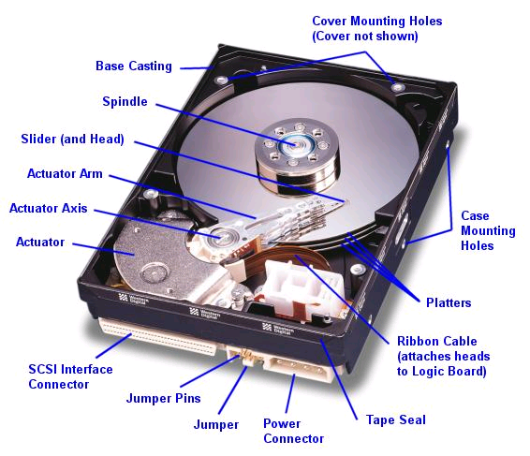
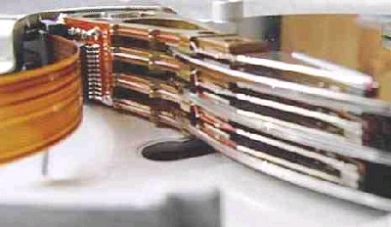
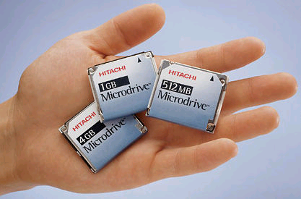
Hard Disk Drives (HDDs)
Read/Write Head
Side View
Western Digital Drive
http://www.storagereview.com/guide/
IBM Personal Computer/AT (1986)
30 MB hard disk - $500
30-40ms seek time
0.7-1 MB/s (est.)
IBM/Hitachi Microdrive
Notes:
Winchester disk drives developed by IBM: 1973 first drive
Uses “sealed” assembly with heads floating on air bearings – Bernoulli effect

Slide 16
The Amazing Magnetic Disk
Unit of Transfer: Sector
Ring of sectors form a track
Stack of tracks form a cylinder
Heads position on cylinders
Disk Tracks ~ 1µm (micron) wide
Wavelength of light is ~ 0.5µm
Resolution of human eye: 50µm
100K tracks on a typical 2.5” disk
Separated by unused guard regions
Reduces likelihood neighboring tracks are corrupted during writes (still a small non-zero chance)

Slide 17
The Amazing Magnetic Disk
Track length varies across disk
Outside: More sectors per track, higher bandwidth
Disk is organized into regions of tracks with same # of sectors/track
Only outer half of radius is used
Most of the disk area in the outer regions of the disk
Disks so big that some companies (like Google) reportedly only use part of disk for active data
Rest is archival data

Slide 18
Shingled Magnetic Recording (SMR)
Overlapping tracks yields greater density, capacity
Restrictions on writing, complex DSP for reading
Examples: Seagate (8TB), Hitachi (10TB)

Slide 19
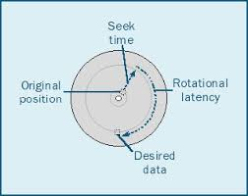
Review: Magnetic Disks
Track
Cylinders: all the tracks under the head at a given point on all surface
Read/write data is a three-stage process:
Seek time: position the head/arm over the proper track
Rotational latency: wait for desired sector to rotate under r/w head
Transfer time: transfer a block of bits (sector) under r/w head
Sector
Head
Cylinder
Platter
Seek time = 4-8ms
One rotation = 8-16ms (3600-7200 RPM)

Slide 20
Review: Magnetic Disks
Track
Cylinders: all the tracks under the head at a given point on all surface
Read/write data is a three-stage process:
Seek time: position the head/arm over the proper track
Rotational latency: wait for desired sector to rotate under r/w head
Transfer time: transfer a block of bits (sector) under r/w head
Sector
Head
Cylinder
Platter
Disk Latency = Queueing Time + Controller time +
Seek Time + Rotation Time + Xfer Time
Software
Queue
(Device Driver)
Hardware
Controller
Media Time
(Seek+Rot+Xfer)
Request
Result

Slide 21
Typical Numbers for Magnetic Disk
Parameter | Info / Range
Space/Density | Space: 14TB (Seagate), 8 platters, in 3½ inch form factor! Areal Density: ≥ 1Terabit/square inch! (PMR, Helium, …)
Average seek time | Typically 4-6 milliseconds. Depending on reference locality, actual cost may be 25-33% of this number.
Average rotational latency | Most laptop/desktop disks rotate at 3600-7200 RPM (16-8 ms/rotation). Server disks up to 15,000 RPM. Average latency is halfway around disk so 8-4 milliseconds
Controller time | Depends on controller hardware
Transfer time | Typically 50 to 250 MB/s. Depends on: Transfer size (usually a sector): 512B – 1KB per sector Rotation speed: 3600 RPM to 15000 RPM Recording density: bits per inch on a track Diameter: ranges from 1 in to 5.25 in
Cost | Used to drop by a factor of two every 1.5 years (or even faster); now slowing down
Notes:
As far as rotational latency is concerned, most disks rotate at 3,600 RPM or approximately 16 ms per revolution.
Since on average, the information you desired is half way around the disk, the average rotational latency will be 8ms.
The transfer time is a function of transfer size, rotation speed, and recording density.
The typical transfer speed is 2 to 4 MB per second.
Notice that the transfer time is much faster than the rotational latency and seek time.
This is similar to the DRAM situation where the DRAM access time is much shorter than the DRAM cycle time.
***** Do anybody remember what we did to take advantage of the short access time versus cycle time? Well, we interleave!
New International Disk Drive, Equipment, and Materials Association standard is 4KB sectors instead of 512 byte sectors
+2 = 36 min. (Y:16)

Slide 22
Disk Performance Example
Assumptions:
Ignoring queuing and controller times for now
Avg seek time of 5ms,
7200RPM ⇒ Time for rotation: 60000 (ms/min) / 7200(rev/min) ~= 8ms
Transfer rate of 50MByte/s, block size of 4Kbyte ⇒ 4096 bytes/50×10⁶ (bytes/s) = 81.92 × 10⁻⁶ sec ≅ 0.082 ms for 1 sector
Read block from random place on disk:
Seek (5ms) + Rot. Delay (4ms) + Transfer (0.082ms) = 9.082ms
Approx 9ms to fetch/put data: 4096 bytes/9.082×10⁻³ s ≅ 451KB/s
Read block from random place in same cylinder:
Rot. Delay (4ms) + Transfer (0.082ms) = 4.082ms
Approx 4ms to fetch/put data: 4096 bytes/4.082×10⁻³ s ≅ 1.03MB/s
Read next block on same track:
Transfer (0.082ms): 4096 bytes/0.082×10⁻³ s ≅ 50MB/sec
Key to using disk effectively (especially for file systems) is to minimize seek and rotational delays

Slide 23
(Lots of) Intelligence in the Controller
Sectors contain sophisticated error correcting codes
Disk head magnet has a field wider than track
Hide corruptions due to neighboring track writes
Sector sparing
Remap bad sectors transparently to spare sectors on the same surface
Slip sparing
Remap all sectors (when there is a bad sector) to preserve sequential behavior
Track skewing
Sector numbers offset from one track to the next, to allow for disk head movement for sequential ops
…

Slide 24
Hard Drive Prices over Time

Slide 25
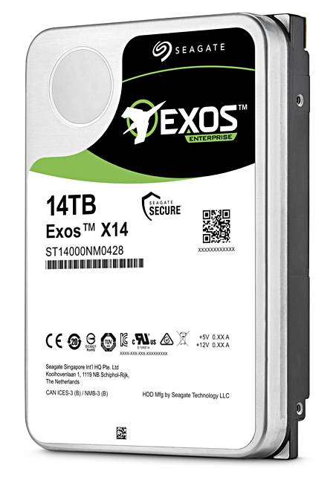
Example of Current HDDs
Seagate Exos X14 (2018)
14 TB hard disk
8 platters, 16 heads
Helium filled: reduce friction and power
4.16ms average seek time
4096 byte physical sectors
7200 RPMs
6 Gbps SATA /12Gbps SAS interface
261MB/s MAX transfer rate
Cache size: 256MB
Price: $615 (< $0.05/GB)
IBM Personal Computer/AT (1986)
30 MB hard disk
30-40ms seek time
0.7-1 MB/s (est.)
Price: $500 ($17K/GB, 340,000x more expensive !!)

Slide 26
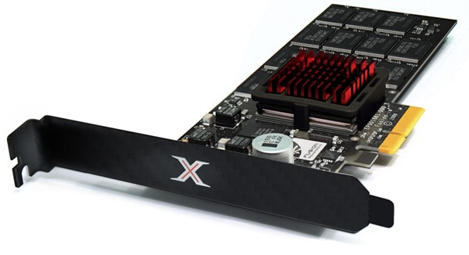
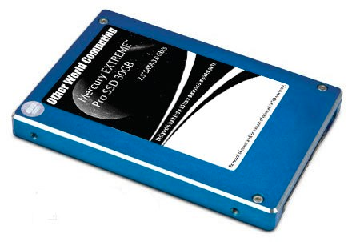
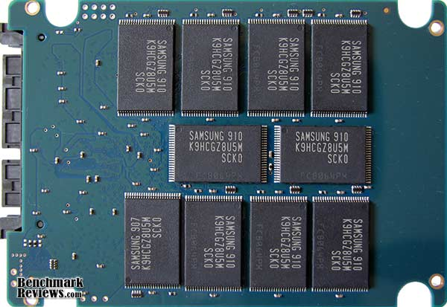
Solid State Disks (SSDs)
1995 – Replace rotating magnetic media with non-volatile memory (battery backed DRAM)
2009 – Use NAND Multi-Level Cell (2 or 3-bit/cell) flash memory
Sector (4 KB page) addressable, but stores 4-64 “pages” per memory block
Trapped electrons distinguish between 1 and 0
No moving parts (no rotate/seek motors)
Eliminates seek and rotational delay (0.1-0.2ms access time)
Very low power and lightweight
Limited “write cycles”
Rapid advances in capacity and cost ever since!

Slide 27
SSD Architecture – Reads
NAND
NAND
NAND
NAND
NAND
NAND
NAND
NAND
Host
Buffer
Manager
(software
Queue)
Flash
Memory
Controller
NAND
NAND
NAND
NAND
SATA
NAND
NAND
NAND
NAND
NAND
NAND
NAND
NAND
DRAM
NAND
NAND
NAND
NAND
NAND
NAND
NAND
NAND
Read 4 KB Page: ~25 usec
No seek or rotational latency
Transfer time: transfer a 4KB page
SATA: 300-600MB/s => ~4 x10³ b / 400 x 10⁶ bps => 10 us
Latency = Queuing Time + Controller time + Xfer Time
Highest Bandwidth: Sequential OR Random reads
NAND
NAND
NAND
NAND

Slide 28
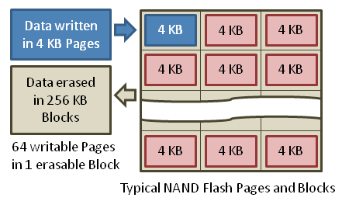
SSD Architecture – Writes
Writing data is complex! (~200μs – 1.7ms )
Can only write empty pages in a block
Erasing a block takes ~1.5ms
Controller maintains pool of empty blocks by coalescing used pages (read, erase, write), also reserves some % of capacity
Rule of thumb: writes 10x reads, erasure 10x writes
https://en.wikipedia.org/wiki/Solid-state_drive

Slide 29

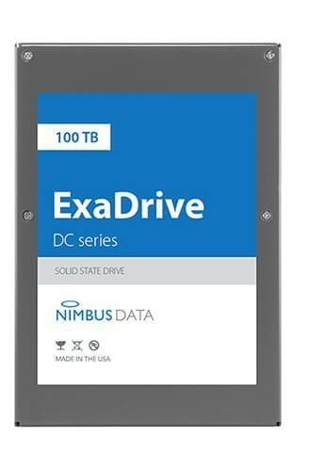
Some “Current” 3.5in SSDs
Seagate Nytro SSD: 15TB (2017)
Dual 12Gb/s interface
Seq reads 860MB/s
Seq writes 920MB/s
Random Reads (IOPS): 102K
Random Writes (IOPS): 15K
Price (Amazon): $6325 ($0.41/GB)
Nimbus SSD: 100TB (2019)
Dual port: 12Gb/s interface
Seq reads/writes: 500MB/s
Random Read Ops (IOPS): 100K
Unlimited writes for 5 years!
Price: ~ $50K? ($0.50/GB)

Slide 30
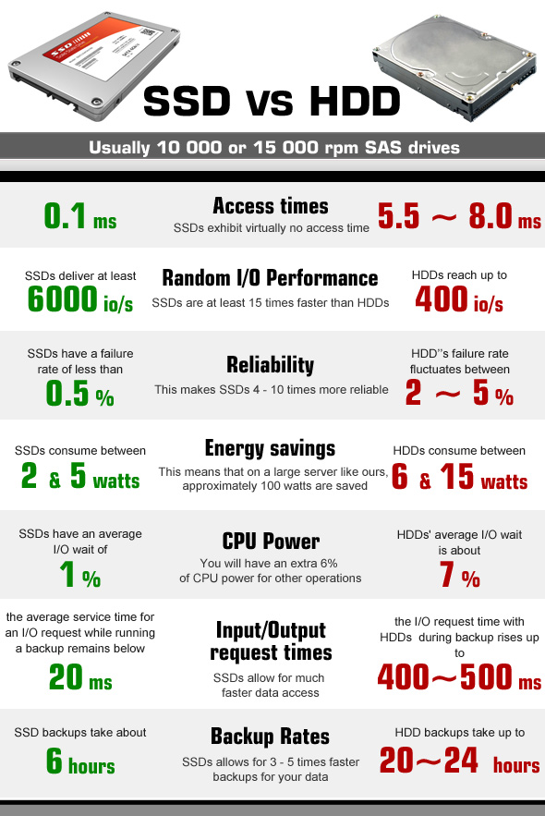
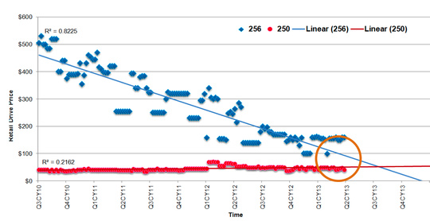
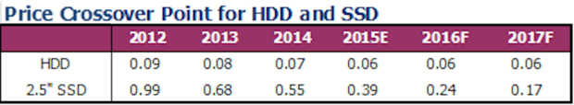
HDD vs SSD Comparison
SSD prices drop much faster than HDD

Slide 31
Amusing calculation: Is a full Kindle heavier than an empty one?
Actually, “Yes”, but not by much
Flash works by trapping electrons:
So, erased state lower energy than written state
Assuming that:
Kindle has 4GB flash
½ of all bits in full Kindle are in high-energy state
High-energy state about 10⁻¹⁵ joules higher
Then: Full Kindle is 1 attogram (10⁻¹⁸gram) heavier (Using E = mc²)
Of course, this is less than most sensitive scale can measure (it can measure 10⁻⁹ grams)
Of course, this weight difference overwhelmed by battery discharge, weight from getting warm, ….
Source: John Kubiatowicz (New York Times, Oct 24, 2011)

Slide 32
SSD Summary
Pros (vs. hard disk drives):
Low latency, high throughput (eliminate seek/rotational delay)
No moving parts:
Very light weight, low power, silent, very shock insensitive
Read at memory speeds (limited by controller and I/O bus)
Cons
Small storage (0.1-0.5x disk), expensive (3-20x disk)
Hybrid alternative: combine small SSD with large HDD

Slide 33
SSD Summary
Pros (vs. hard disk drives):
Low latency, high throughput (eliminate seek/rotational delay)
No moving parts:
Very light weight, low power, silent, very shock insensitive
Read at memory speeds (limited by controller and I/O bus)
Cons
Small storage (0.1-0.5x disk), expensive (3-20x disk)
Hybrid alternative: combine small SSD with large HDD
Asymmetric block write performance: read pg/erase/write pg
Controller garbage collection (GC) algorithms have major effect on performance
Limited drive lifetime
1-10K writes/page for MLC NAND
Avg failure rate is 6 years, life expectancy is 9–11 years
These are changing rapidly!
No longer true!

Slide 34
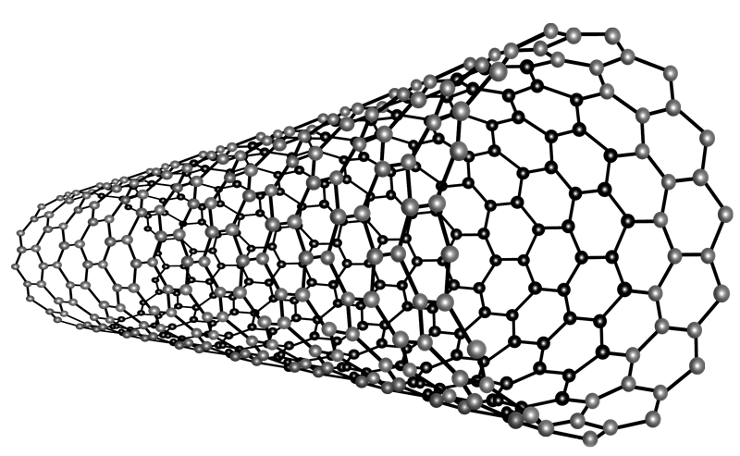
Nano-Tube Memory (NANTERO)
Yet another possibility: Nanotube memory
NanoTubes between two electrodes, slight conductivity difference between ones and zeros
No wearout!
Better than DRAM?
Speed of DRAM, no wearout, non-volatile!
Nantero promises 512Gb/dice for 8Tb/chip! (with 16 die stacking)

Slide 35
I/O Performance
300
Response
Time (ms)
Controller
User
Thread
I/O
device
200
Queue
[OS Paths]
100
Response Time = Queue + I/O device service time
0
Performance of I/O subsystem
Metrics: Response Time, Throughput
Effective BW per op = transfer size / response time
EffBW(n) = n / (S + n/B) = B / (1 + SB/n )
0%
100%
Throughput (Utilization)
(% total BW)
# of ops
time per op
Fixed overhead

Slide 36
I/O Performance
300
Response
Time (ms)
Controller
User
Thread
I/O
device
200
Queue
[OS Paths]
100
Response Time = Queue + I/O device service time
0
Performance of I/O subsystem
Metrics: Response Time, Throughput
Effective BW per op = transfer size / response time
EffBW(n) = n / (S + n/B) = B / (1 + SB/n )
Contributing factors to latency:
Software paths (can be loosely modeled by a queue)
Hardware controller
I/O device service time
Queuing behavior:
Can lead to big increases of latency as utilization increases
Solutions?
0%
100%
Throughput (Utilization)
(% total BW)

Slide 37
A Simple Deterministic World
arrivals
Queue
Server
departures
T_{Q}
T_{S}
T_{A}
T_{A}
T_{A}
T_{q}
T_{S}
Assume requests arrive at regular intervals, take a fixed time to process, with plenty of time between …
Service rate (μ = 1/T_{S}) - operations per second
Arrival rate: (λ = 1/T_{A}) - requests per second
Utilization: U = λ/μ , where λ < μ
Average rate is the complete story

Slide 38
A Ideal Linear World
Saturation
1
1
Delivered Throughput
Delivered Throughput
Empty Queue
Unbounded
0
1
0
1
Offered Load (T_{S}/T_{A})
Offered Load (T_{S}/T_{A})
Queue delay
Queue delay
time
time
What does the queue wait time look like?
Grows unbounded at a rate ~ (T_{s}/T_{A}) till request rate subsides

Slide 39
A Bursty World
arrivals
Queue
Server
departures
T_{Q}
T_{S}
Arrivals
Q depth
Server
Requests arrive in a burst, must queue up till served
Same average arrival time, but almost all of the requests experience large queue delays
Even though average utilization is low

Slide 40
So how do we model the burstiness of arrival?
Elegant mathematical framework if you start with exponential distribution
Probability density function of a continuous random variable with a mean of 1/λ
f(x) = λe^{-λx}
“Memoryless”
Likelihood of an event occurring is independent of how long we’ve been waiting
mean arrival interval (1/λ)
Lots of short arrival intervals (i.e., high instantaneous rate)
Few long gaps (i.e., low instantaneous rate)
x (λ)

Slide 41
Background: General Use of Random Distributions
Mean
(m)
Server spends variable time (T) with customers
Mean (Average) m = Σp(T)×T
Variance (stddev²) σ² = Σp(T)×(T-m)² = Σp(T)×T²-m²
Squared coefficient of variance: C = σ²/m² Aggregate description of the distribution
Important values of C:
No variance or deterministic ⇒ C=0
“Memoryless” or exponential ⇒ C=1
Past tells nothing about future
Poisson process – purely or completely random process
Many complex systems (or aggregates) are well described as memoryless
Disk response times C ≈ 1.5 (majority seeks < average)
σ
Distribution
of service times
mean
Memoryless

Slide 42
Introduction to Queuing Theory
Controller
Arrivals
Disk
Departures
Queue
Queuing System
What about queuing time??
Let’s apply some queuing theory
Queuing Theory applies to long term, steady state behavior ⇒ Arrival rate = Departure rate
Arrivals characterized by some probabilistic distribution
Departures characterized by some probabilistic distribution
Notes:
Old and New Testament by Kleirock
Regret skipping as grad student

Slide 43
Little’s Law
N
arrivals
departures
λ
L
In any stable system
Average arrival rate = Average departure rate
The average number of jobs/tasks in the system (N) is equal to arrival time / throughput (λ) times the response time (L)
N (jobs) = λ (jobs/s) x L (s)
Regardless of structure, bursts of requests, variation in service
Instantaneous variations, but it washes out in the average
Overall, requests match departures

Slide 44
Example
L = 5
λ = 1
L = 5
N = 5 jobs
Jobs
0
1
2
3
4
5
6
7
8
9
10
11
12
13
14
15
16
time
A: N = λ x L
E.g., N = λ x L = 5

Slide 45
Little’s Theorem: Proof Sketch
N
arrivals
departures
λ
Job i
L(i) = response time of job i
N(t) = number of jobs in system
at time t
L
N(t)
time
L(1)
T

Slide 46
Little’s Theorem: Proof Sketch
N
arrivals
departures
λ
Job i
L(i) = response time of job i
N(t) = number of jobs in system
at time t
L
N(t)
time
T
What is the system occupancy, i.e., average
number of jobs in the system?

Slide 47
Little’s Theorem: Proof Sketch
N
arrivals
departures
λ
Job i
L(i) = response time of job i
N(t) = number of jobs in system
at time t
S(i) = L(i) * 1 = L(i)
L
S(k)
N(t)
S(2)
S(1)
time
T
S = S(1) + S(2) + … + S(k) = L(1) + L(2) + … + L(k)

Slide 48
Little’s Theorem: Proof Sketch
N
arrivals
departures
λ
Job i
L(i) = response time of job i
N(t) = number of jobs in system
at time t
S(i) = L(i) * 1 = L(i)
L
N(t)
S= area
time
T
Average occupancy (N_{avg}) = S/T

Slide 49
Little’s Theorem: Proof Sketch
N
arrivals
departures
λ
Job i
L(i) = response time of job i
N(t) = number of jobs in system
at time t
S(i) = L(i) * 1 = L(i)
L
S(k)
N(t)
S(2)
S(1)
time
T
N_{avg} = S/T = (L(1) + … + L(k))/T

Slide 50
Little’s Theorem: Proof Sketch
N
arrivals
departures
λ
Job i
L(i) = response time of job i
N(t) = number of jobs in system
at time t
S(i) = L(i) * 1 = L(i)
L
S(k)
N(t)
S(2)
S(1)
time
T
N_{avg} = (L(1) + … + L(k))/T = (N_{total}/T)*(L(1) + … + L(k))/N_{total}

Slide 51
Little’s Theorem: Proof Sketch
N
arrivals
departures
λ
Job i
L(i) = response time of job i
N(t) = number of jobs in system
at time t
S(i) = L(i) * 1 = L(i)
L
S(k)
N(t)
S(2)
S(1)
time
T
N_{avg} = (N_{total}/T)*(L(1) + … + L(k))/N_{total} = λ_{avg} × L_{avg}

Slide 52
Little’s Theorem: Proof Sketch
N
arrivals
departures
λ
Job i
L(i) = response time of job i
N(t) = number of jobs in system
at time t
S(i) = L(i) * 1 = L(i)
L
S(k)
N(t)
S(2)
S(1)
time
T
N_{avg} = λ_{avg} × L_{avg}

Slide 53
A Little Queuing Theory: Some Results
Assumptions:
System in equilibrium; No limit to the queue
Time between successive arrivals is random and memoryless
Parameters that describe our system:
λ: mean number of arriving customers/second
T_{ser}: mean time to service a customer (“m1”)
C: squared coefficient of variance = σ²/m1²
μ: service rate = 1/T_{ser}
u: server utilization (0≤u≤1): u = λ/μ = λ × T_{ser}
Parameters we wish to compute:
T_{q}: Time spent in queue
L_{q}: Length of queue = λ × T_{q} (by Little’s law)
Results:
Memoryless service distribution (C = 1): (an “M/M/1 queue”):
T_{q} = T_{ser} x u/(1 – u)
General service distribution (no restrictions), 1 server (an “M/G/1 queue”):
T_{q} = T_{ser} x ½(1+C) x u/(1 – u)
Why does response/queueing delay grow unboundedly even though the utilization is < 1 ?
Queue
Server
Arrival Rate
λ
Service Rate
μ=1/T_{ser}
Response
Time (ms)
300
200
100
0
0%
100%
Throughput (Utilization)
(% total BW)

Slide 54
Why unbounded response time?
Assume deterministic arrival process and service time
Possible to sustain utilization = 1 with bounded response time!
time
arrival time
service time

Slide 55
Why unbounded response time?
300
Response
Time (ms)
Assume stochastic arrival process (and service time)
No longer possible to achieve utilization = 1
200
100
This wasted time can never be reclaimed! So cannot achieve u = 1!
0
0%
100%
Throughput (Utilization)
(% total BW)
time

Slide 56
A Little Queuing Theory: An Example
Example Usage Statistics:
User requests 10 x 8KB disk I/Os per second
Requests & service exponentially distributed (C=1.0)
Avg. service = 20 ms (From controller+seek+rot+trans)
Questions:
How utilized is the disk?
Ans: server utilization, u = λT_{ser}
What is the average time spent in the queue?
Ans: T_{q}
What is the number of requests in the queue?
Ans: L_{q}
What is the avg response time for disk request?
Ans: T_{sys} = T_{q} + T_{ser}
Computation:
λ (avg # arriving customers/s) = 10/s
T_{ser} (avg time to service customer) = 20 ms (0.02s)
u (server utilization) = λ x T_{ser}= 10/s x .02s = 0.2
T_{q} (avg time/customer in queue) = T_{ser} x u/(1 – u) = 20 x 0.2/(1-0.2) = 20 x 0.25 = 5 ms (0 .005s)
L_{q} (avg length of queue) = λ x T_{q}=10/s x .005s = 0.05
T_{sys} (avg time/customer in system) =T_{q} + T_{ser}= 25 ms

Slide 57
Queuing Theory Resources
Resources page contains Queueing Theory Resources (under Readings):
Scanned pages from Patterson and Hennessy book that gives further discussion and simple proof for general equation: https://cs162.eecs.berkeley.edu/static/readings/patterson_queue.pdf
A complete website full of resources: http://web2.uwindsor.ca/math/hlynka/qonline.html
Some previous midterms with queueing theory questions
Assume that Queueing Theory is fair game for Midterm III!

Slide 58
Summary
Disk Performance:
Queuing time + Controller + Seek + Rotational + Transfer
Rotational latency: on average ½ rotation
Transfer time: spec of disk depends on rotation speed and bit storage density
Devices have complex interaction and performance characteristics
Response time (Latency) = Queue + Overhead + Transfer
Effective BW = BW * T/(S+T)
HDD: Queuing time + controller + seek + rotation + transfer
SDD: Queuing time + controller + transfer (erasure & wear)
Systems (e.g., file system) designed to optimize performance and reliability
Relative to performance characteristics of underlying device
Bursts & High Utilization introduce queuing delays
Queuing Latency:
M/M/1 and M/G/1 queues: simplest to analyze
As utilization approaches 100%, latency → ∞
T_{q} = T_{ser} x ½(1+C) x u/(1 – u))

